Slide 1
A promising ‘one-size-fits-all’ cancer treatment

Slide 2

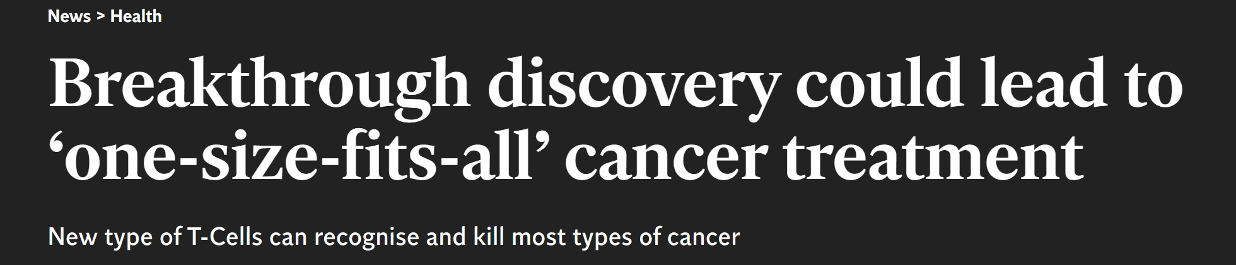

Slide 3
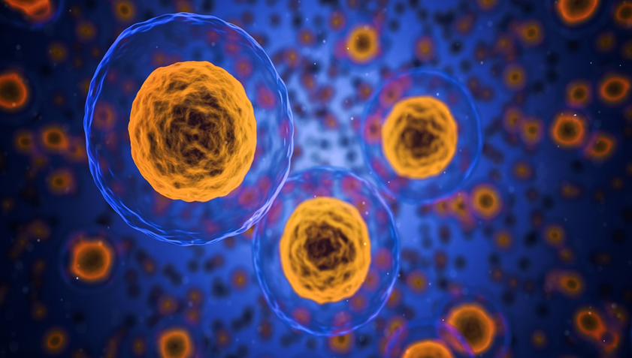
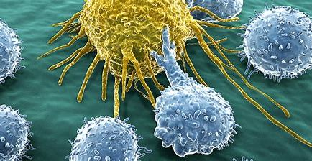
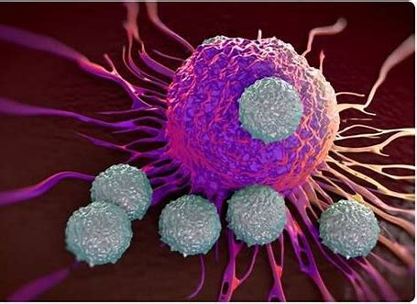
some remedies for cancer
Surgery
Chemotherapy
Radiation therapy
T-cell therapy(also known as CAR-T)
....

Slide 4
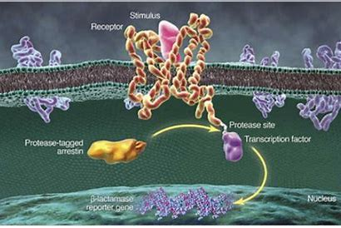
How T-cell therapy works
T-cells are cells collected from your body.
They are modified to kill cancer cells.
First, scan the surface of other cells:
“The scanning recognises small parts of cellular proteins that are bound to cell-surface molecules called human leukocyte antigen (HLA), allowing killer T-cells to see what is occurring inside cells by scanning their surface”;
Second, find anomalies and eliminate cancerous cells.

Slide 5
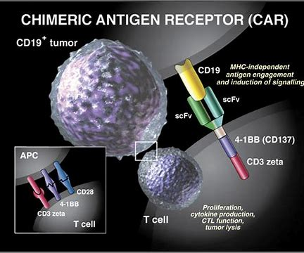
T-cell therapy the latest paradigm in cancer treatments
T-cell therapy:
pros:
1.“where immune cells are removed, modified and returned to the patient's blood to seek and destroy cancer cells”;
2.“personalised to each patient”
Cons:“it only targets a limited number of cancers and has not been successful for solid tumours, which make up the majority of cancers.”

Slide 6
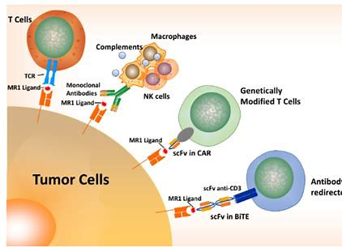
A new kind of discovered T-cells MR1-restricted T-cells
features:
1. “recognises a molecule present on the surface of a wide range of cancer cells, and normal cells”
2.“is able to distinguish between healthy and cancerous cells — killing only the latter”

Slide 7
compared to the normal T-cell
MR1-restricted T-cells:
1. recognise many types of cancers via a single HLA-like molecule called MR1;
2. kill cancer cells while ignoring healthy cells
MR1: Unlike HLA, MR1 does not vary in the human population.
Conventional T-cells :
1. only be used in a minority of patients with a minority of cancers;
2. might kill healthy cells accidentally.

Slide 8

The current stage
The researchers are now experimenting to determine the precise molecular mechanism by which the new T-cell distinguishes between healthy cells and cancer.
They hope to trial the new approach in patients towards the end of the year.

Slide 9
The future
1.lay the foundation for a universal cancer remedy
2.reduce the tremendous costs spent on the “identification, generation and manufacture of personalised T-cells”

Slide 10
Reference
https://www.independent.co.uk/news/health/cancer-treatment-therapy-t-cell-universal-tumor-cardiff-university-a9292716.html

Slide 11
Thanks for your listening!

